Slide 1
DevOps at HPE
Rafael Garcia @RafGar2
Olivier Jacques @OJacques2
Ashish Kuthiala @kuthiala

Slide 2



HPE IT by the Numbers
Methods Waterfall, Agile/Scrum
2 + 2 datacenters
Plus local R&D labs
45,000
L1 support interactions per month
900 projects
In 2015
20,000+ Change Requests / year Incl. 143,000 tasks
100s Development Teams
1000s Builds per Day
Millions+ Lines of Code
Changed Every day
11 countries With >100 IT employees
1,400 IT supported apps
160k tickets per month – 70% from monitoring
7K+ Dev + Ops
1000s Engineering Wiki Pages
Notes:
Ashish: Isn't that cool? This is the future we have been dreaming of as kids.
That future is here. IOT, Composable infrastructure, Big Data, Machine Learning: all of this is now coming together so that humanity can collaborate better than ever before.
Rafael: we were competing based on capital, now we are competing with companies which did not exist 2 years ago. This has ripple effects on how we innovate and how we deliver value.
Olivier: key figures on what HPE IT is
1400 apps supported by IT, 2500 in total to run HP
900 IT projects active in 2015
7k Dev + Ops
Rafael: We started our DevOps journey

Slide 3
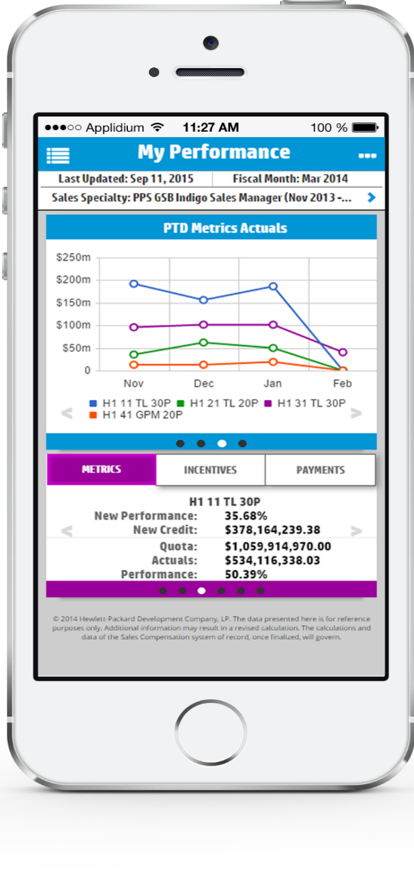









2 applications moved to DevOps
MyComp mobile
HPE Support Automation
Server
Product Engineers
Sys
Admin
Service Delivery
Server
KM
Storage
Sales Partner
A “Social Network” of machines and people
Sales
Blades
Analytics
Support Partner
IT Director
Component
OS
Apps
Switch
Customer Exec
Support Specialist
Notes:
Rafael:
Let’s look at two of our apps. You know, we are well in our Journey. We started to do DevOps in an organized manner across HPE IT late 2014. We have a number of assets which are adopting the DevOps model, accept the end to end ownership, and we have more knocking at the door every day, which is awesome.
In our progress report, there are 2 assets that we will highlight:
MyComp mobile:
The most used mobile app by our 10,000 HP sales people. They see where they are with objectives and their compensations. Any improvement here, helps sales, and thus revenues
HPE Support Platform 2.0:
HP’s new generation support platform where machines, equipment's, support specialists, IT directors, are all meshed into a gigantic social network. We serve 18,000 customers with this platform. Improvement here drives customer satisfaction up. And that’s what we are about

Slide 4

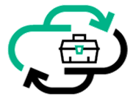





HPE IT’s DevOps Manifesto
Optimized | More about accomplishing the goal rather than being prescriptive of how we achieve that | APIs | Resources are controlled by APIs Everything is code
Inner Source | All of our code is Inner Source by default. | Pipelines | We have all changes go through our continuous delivery pipelines: application, compute, storage, DB, network, OS
Scientific | We formulate hypotheses; validate them with experience and data | Teams | Integrated, empowered, self organizing teams
Trust |  | We value trust and responsibility
Notes:
Olivier:
As we started our DevOps transformation, we needed to agree on a common understanding.
We are going to highlight 3.
1. Common language - Manifesto
2. Transparency (thru) ChatOps – nothing is hidden inside the silos
3. Common Objective

Slide 5
Collaboration
1
Without playing with org charts
Notes:
Ashish:
Collaboration is easier said than done. At the end of the day, we are all part of an organization….
We often hear: “DevOps is a re-org”. Although in spirit we agree, in practice, for an enterprise of our size, this is not very practical. Or not in one go.

Slide 6
Our organization
Dev + QA
Change Management
Infrastructure
(cloud, DBA, Security)
Support
Notes:
Our organization was, and still is, a classical silo organization.

Slide 7
Our organization
Dev + QA
Change Management
Infrastructure
(cloud, DBA, Security)
Support
#ChatOps
Notes:
Our organization was, and still is, a classical silo organization.

Slide 8
ChatOps?
Persistent Chat Rooms
+
(People and Systems)

Slide 9
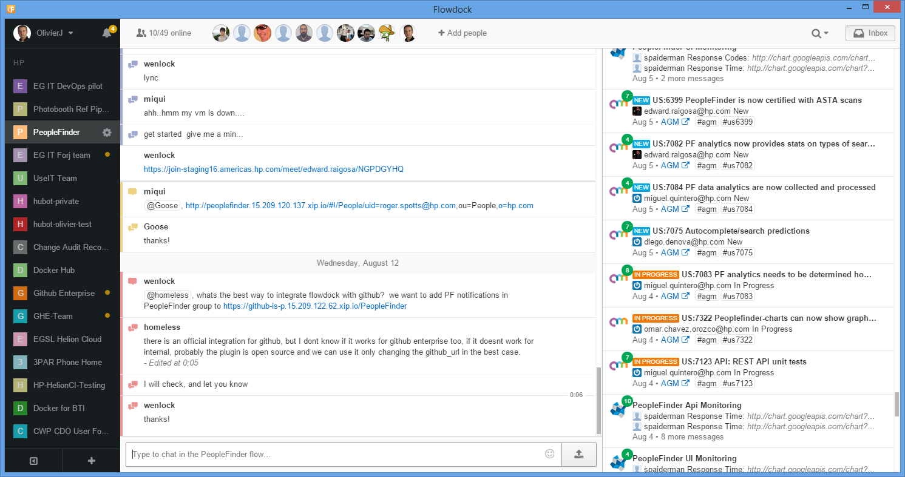
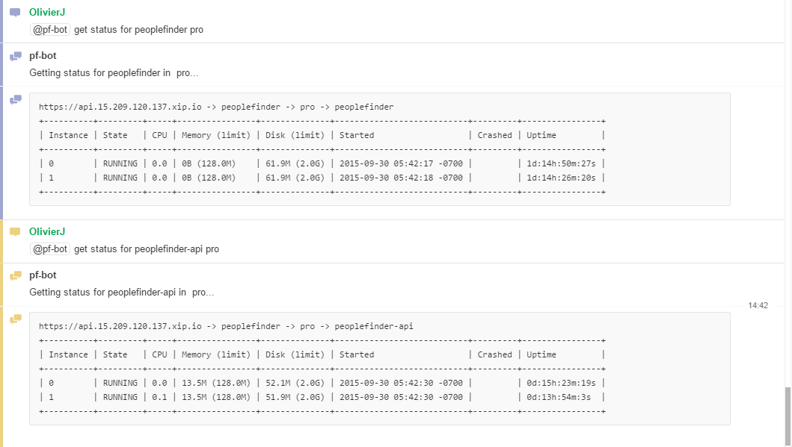
ChatOps: Augmented reality for Dev + Ops
Notes:
Ashish: transparency

Slide 10
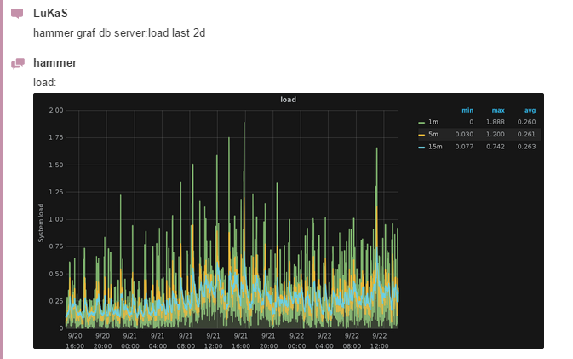
ChatOps: Augmented reality for Dev + Ops
Notes:
Bot capabilities / ecosystem interactions
Magic of ChatOps – not just transparency – now, you are interacting with the ecosystem
Example – Monitoring…

Slide 11
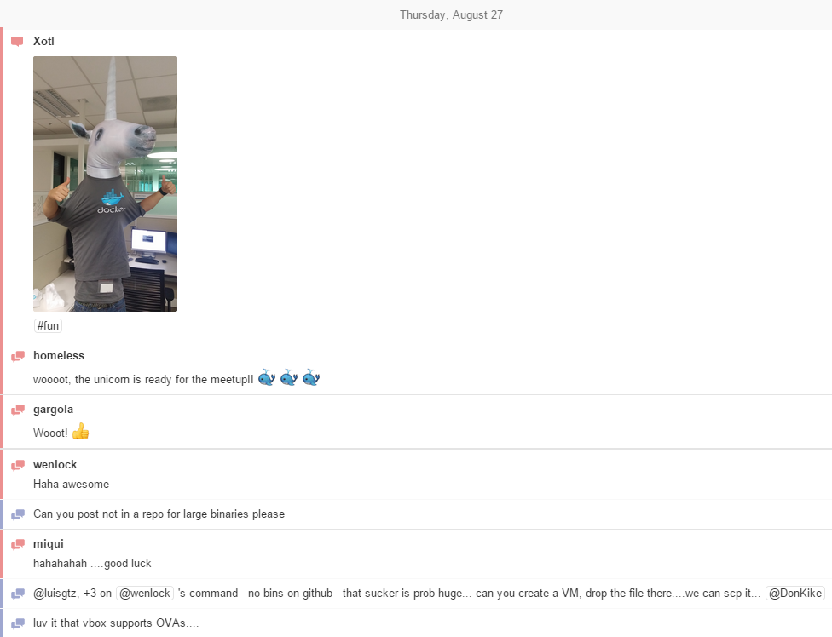
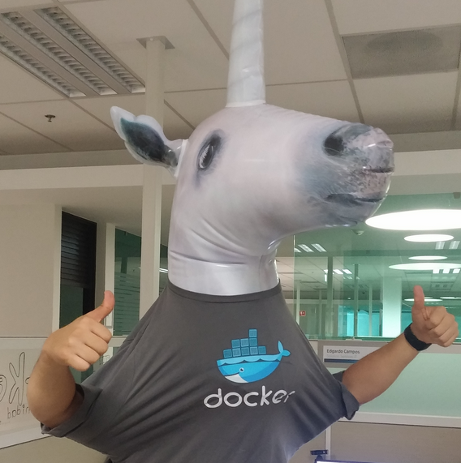



ChatOps: Augmented reality for Dev + Ops
Fun too: adds work to social!
Notes:
3. Fun aspect

Slide 12

Still siloed but work as one team…
Dev
Support
Infrastructure
(cloud, DBA, Security)
Change Management
QA
#ChatOps
Notes:
Our organization was, and still is, a classical silo organization.

Slide 13
Pipelines & Buoys
2
One size does NOT fit all
Notes:
Olivier:
At HPE, we do not have conversations about tools anymore, we have conversations about pipelines.
Basically looking at the tool landscape from an holistic, end-to-end perspective.
We are also very much convinced that one size does not fit all. Given the breadth of our portfolio, we basically need to have custom pipelines for each asset.
How do we do that?

Slide 14







Flexible Continuous Delivery Pipeline
Source Code Management
Change Records
Flexible pipelines with anchor points
Telemetry
Notes:
Concept of CD pipeline: move good changes as quickly and as automatically as possible and reject bad changes as quickly and as automatically as possible.
As we have freedom regarding the pipeline, we also have several (couple of ) “anchor points”, which are non-negotiable, such as:
Source code management platform
Change record service
Coding the process in the CD pipeline…
Flexible CD pipeline – we don’t define every tool/aspect of pipeline (not perceptive). Some aspects non-negotiable. Standardize some, example: – source code management. (see notes above).

Slide 15
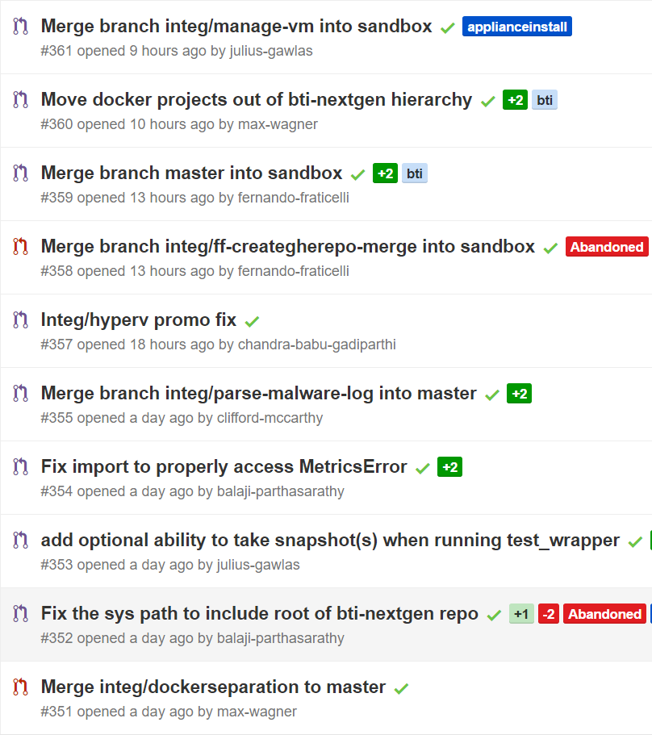
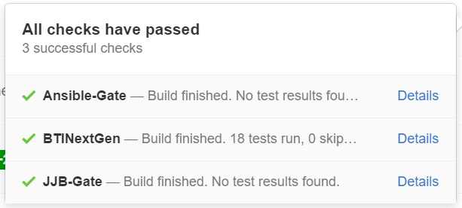
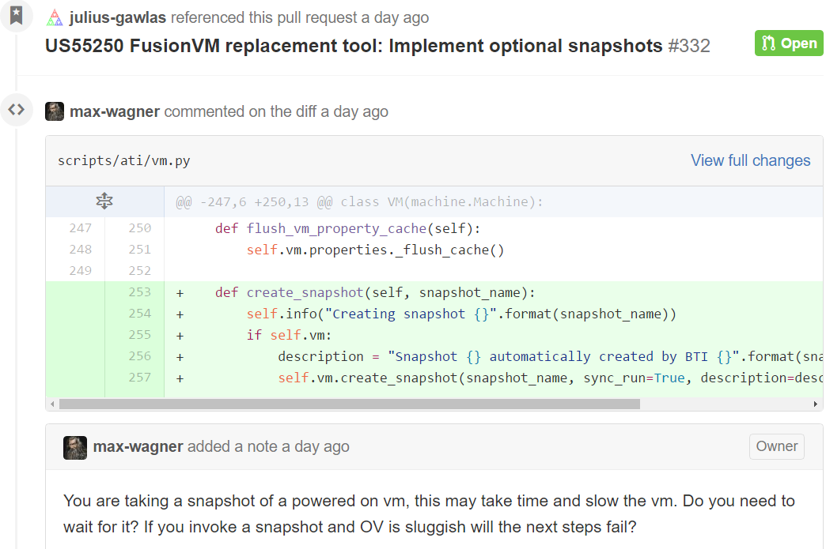
Anchor point: Source code management
One change = One deploy (at least in test env)
Lightweight peer reviews
ChatOps integration
Notes:
The 1st anchor point is Source Code Management.
It’s an anchor point because we want all of the code of HPE to be shared – when applicable – across our employees. It’s a social coding model.
Very critical as everything is progressively threated as code: the application, the configuration, the data model, the infrastructure.
It is also a corner stone in integrating pieces of our pipeline.
Characteristics:
- one change = one deploy – at least in test
-light weight peer reviews
- ChatOps integration

Slide 16
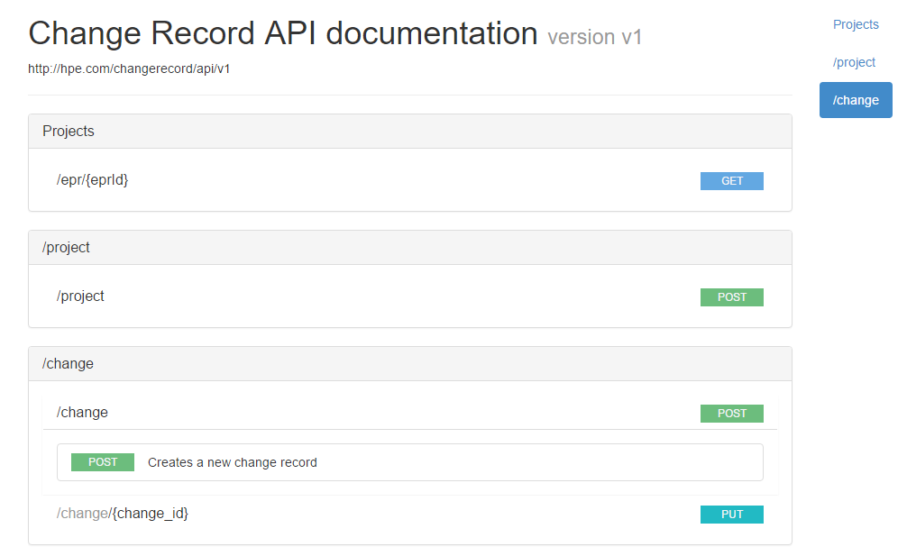
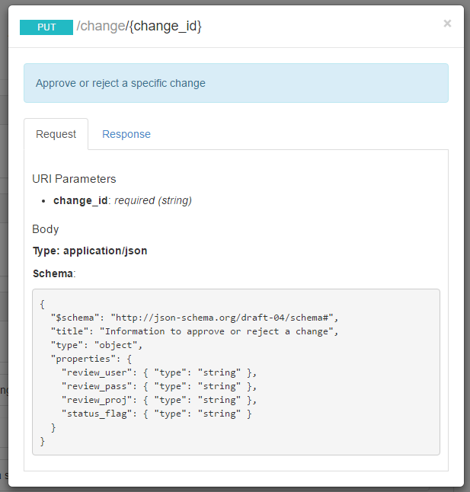
Anchor point: Change Records
Our auditor’s dream
Notes:
Change service records:
When we entered the DevOps kickoff meeting, we had a pretty intense process which we call the “RfC” process. Changes where being submitted, and approved. But they were reviewed & approved for the wrong reasons. For template conformance: an entry in this particular field, and that “UAT oK” checkbox checked.
So, after working with the Change management team, we came up with a way to codify and automate, on top of our CD pipeline, the change management process.
- Much closer to the System of Records
- Fully traceable

Slide 17
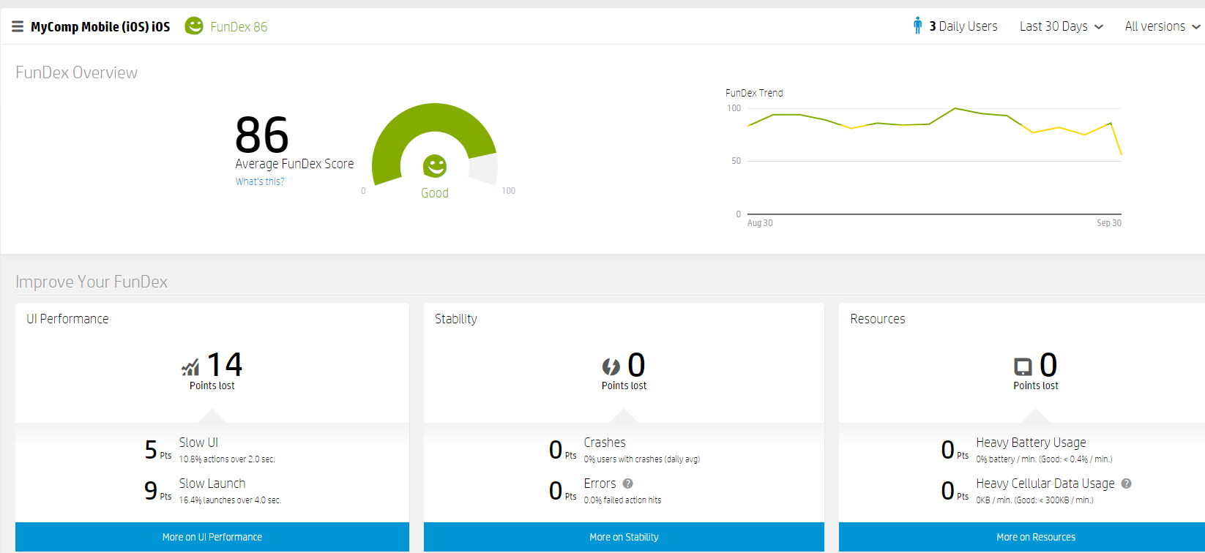
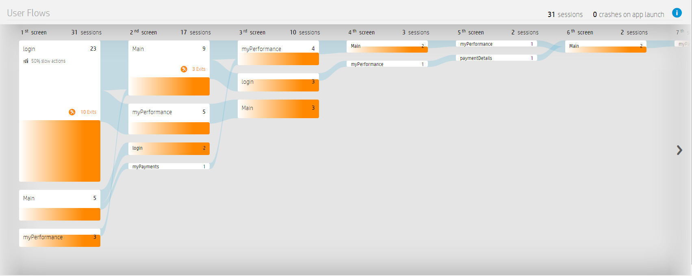
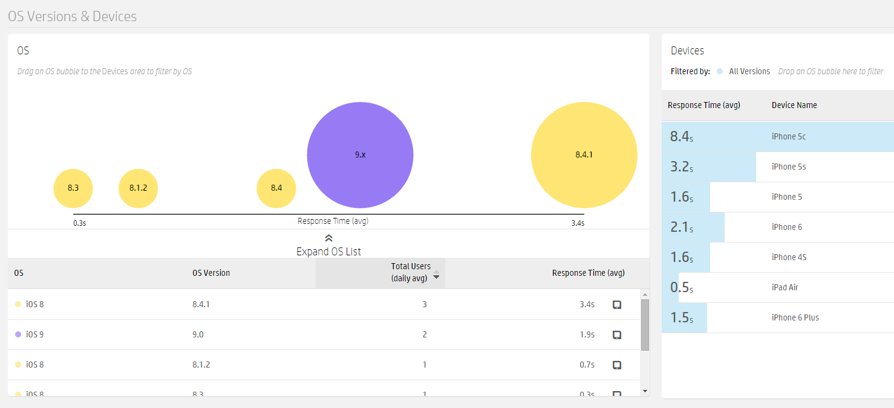
Telemetry
Notes:
And because the feedback loop is extremely important, teams have been big on telemetry. At HP we have many enterprise monitoring solutions. For myComp, the one that is used the most is AppPulse mobile, which shows lots of useful data.
What screens users navigate to
What OS version do perform or which one do we have to dig deeper and chase performance issues
Best of all, we have integrated this as a FunDex score, which is a composite metric of UI performance, stability and resource consumption like battery and cellular data
All this data is in the hand of the integrated DevOps teams, not only the Operations team anymore. And this drive the right behaviors for the DevOps teams. Everybody fights to influence the FunDex score!

Slide 18

Buoys, Not Boundaries
Notes:
Rafael:
IT leadership is accustomed to imposing standards and control. DevOps requires flexibility to innovate, so leaders must strike that balance.
Keep developers “in the channel” but allow some experimentation at the edges

Slide 19
Trust
3
…but verify
Notes:
Rafael:
We talked a lot about technology. But the biggest enabler for us has been people. You’ve seen that with our ChatOps environment.
The other dimension is trust. And verification.

Slide 20
Integrated and empowered teams
Trust
Control
Minimum Viable Process
Trust, but verify.
Notes:
Empower teams:
- With empowerment comes pains – not only benefits
Team composition, DevOps guru, set new boundaries, …
Anchor points (Minimum Viable Process)
Change Record service
Others: security scan, …

Slide 21
HPE IT’s DevOps Manifesto
Optimized | More about accomplishing the goal rather than being prescriptive of how we achieve that | APIs | Resources are controlled by APIs Everything is code
Inner Source | All of our code is Inner Source by default. | Pipelines | We have all changes go through our continuous delivery pipelines: application, compute, storage, DB, network, OS
Scientific | We formulate hypotheses; validate them with experience and data | Teams | Integrated, empowered, self organizing teams
Trust |  | We value trust and responsibility
Notes:
Trust has been a foundation, and a real departure from our previous IT culture. But we found that trust has been the one element that is making a world of difference.

Slide 22
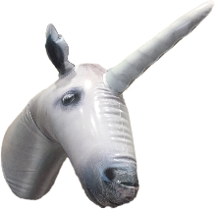
HPE IT’s DevOps journey
1
2
3
Unicorns
Pockets of awesome
Pilot & define “new world”
HPE IT DevOps manifesto
Discovery
~ 10 pilot assets
Anchor points
New processes
Tools & technology
Scale up
DevOps Community
DevOps dojo + Continuous Improvement Kaizen
Inner sourcing/social coding
Systemic vs. exception-based

Slide 23
Thank you!

